Slide 1

Learning with Multimedia
Kevin Picazo-Gonzalez

Slide 2
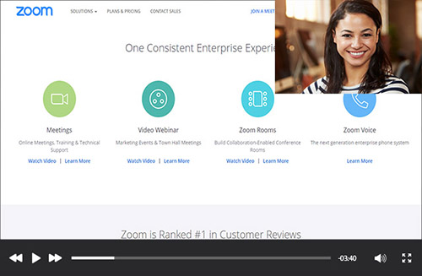




Introduction

Slide 3



Video
Interactive and thought–provoking capabilities
Useful for presenting information
Can trigger strong feelings

Slide 4

Graphics and Animation
Graphics improves and motivate
Graphics have visual appeal
Animation enhances thinking

Slide 5


Audio and Text
Audio connects text-based concepts
Presenting must have sound
Text primarily distributes information

Slide 6


Conclusion
Importance and Impact

